Slide 1
No Quiz today!
Data Ethics, Privacy, and Law

Slide 2
This week: designing & acquiring data
Today
Review: what data means in an AI/ML pipeline
Hey, why is it a pipeline?
Data sources
Curated public datasets
Curated private datasets (crowdsourced)
Data from users
Privacy theory and regulations
Thursday
Crowdsourcing
Workforce ethics
Designing for crowd pipelines

Slide 3
Where does data come from?
An AI/ML augmented experience
Data Source
ML Engineering
Users

Slide 4
Where does data come from?
???
An AI/ML augmented experience
Data Source
ML Engineering
Users

Slide 5

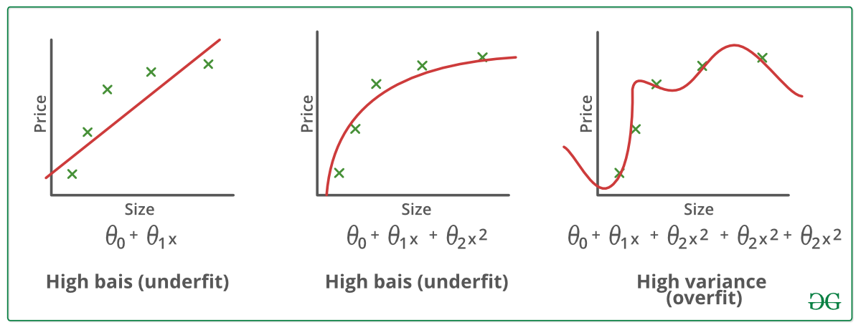
Achieving a model that can generalize to new data
Terms for model fit:
underfit / overfit
bias / variance
Notes:
Image source: https://www.geeksforgeeks.org/underfitting-and-overfitting-in-machine-learning/

Slide 6
Achieving a model that can generalize to new data
We want to avoid overfitting to any single one of these datasets.
We need use “fresh” data to test out whether our model is overfitting.
That is the why multiple datasets are needed during model building.
Training set
ML Model
Validation set
Test set

Slide 7
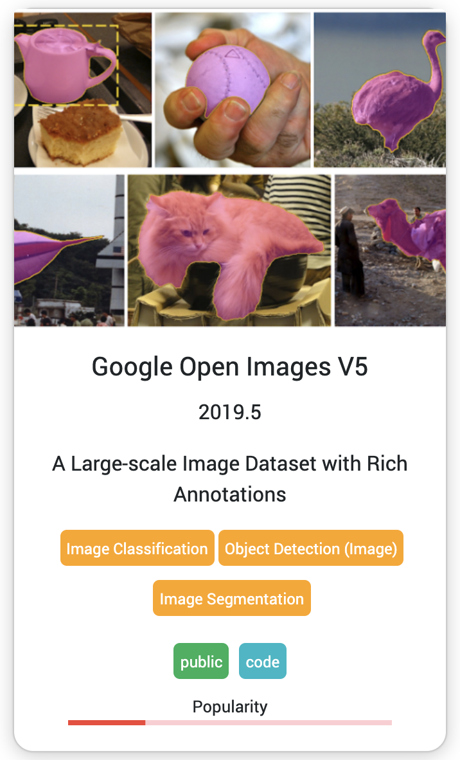
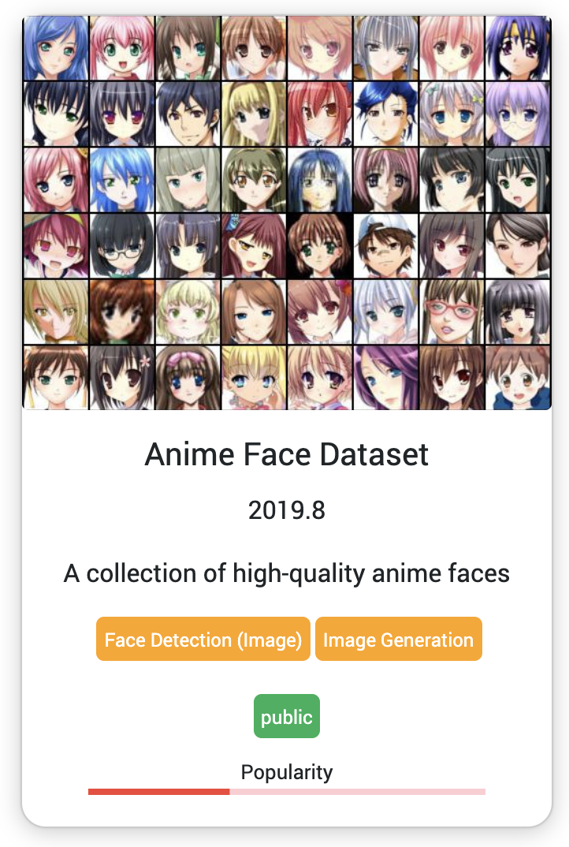
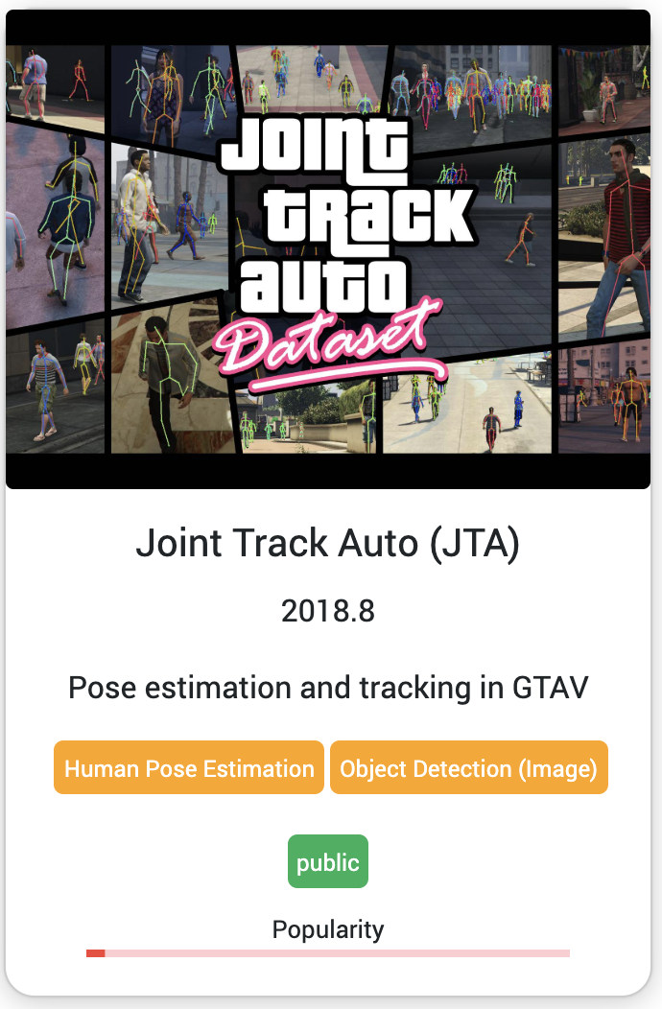
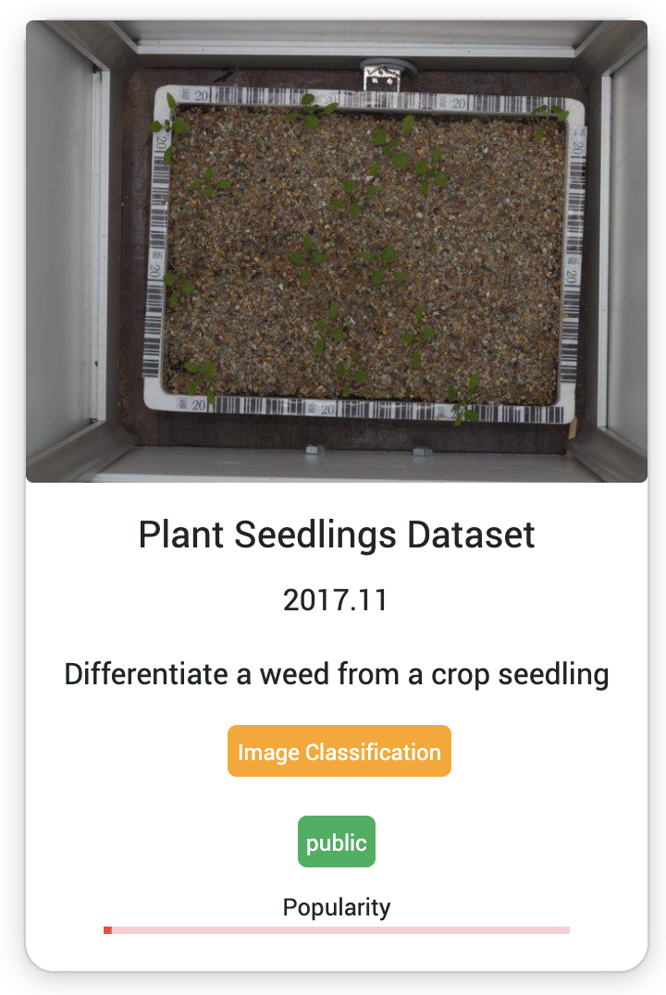
Standard open data sources
Wordnet & Imagenet
A lexical database for english
Imagenet provides thousands of images per word
Open government datasets
Public dataset repositories
e.g., examples from visualdata.io
Does your goal require annotated data?
How do you judge if & how well a public dataset meets your goals?
Notes:
Image sources: https://www.visualdata.io/

Slide 8
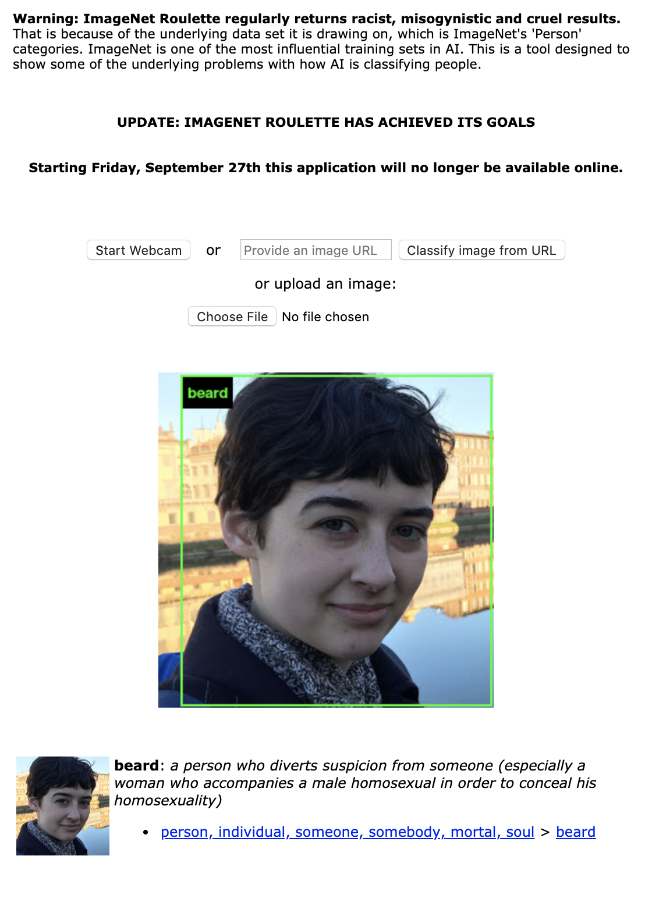
ImageNet
“The ImageNet dataset is typically used for object recognition. But as part of the research for the forthcoming “Excavating AI” project by Trevor Paglen and Kate Crawford, we were interested to see what would happen if we trained an AI model exclusively on its “Person” categories. ImageNet contains 2833 sub-categories under the top-level category “Person.” The sub-category with the most associated pictures is “gal” (with 1664 images) followed by “grandfather” (1662), “dad” (1643), and “chief executive officer” (1614). ImageNet classifies people into a huge range of types including race, nationality, profession, economic status, behavior, character, and even morality.”
ImageNet Roulette
Notes:
https://imagenet-roulette.paglen.com/

Slide 9
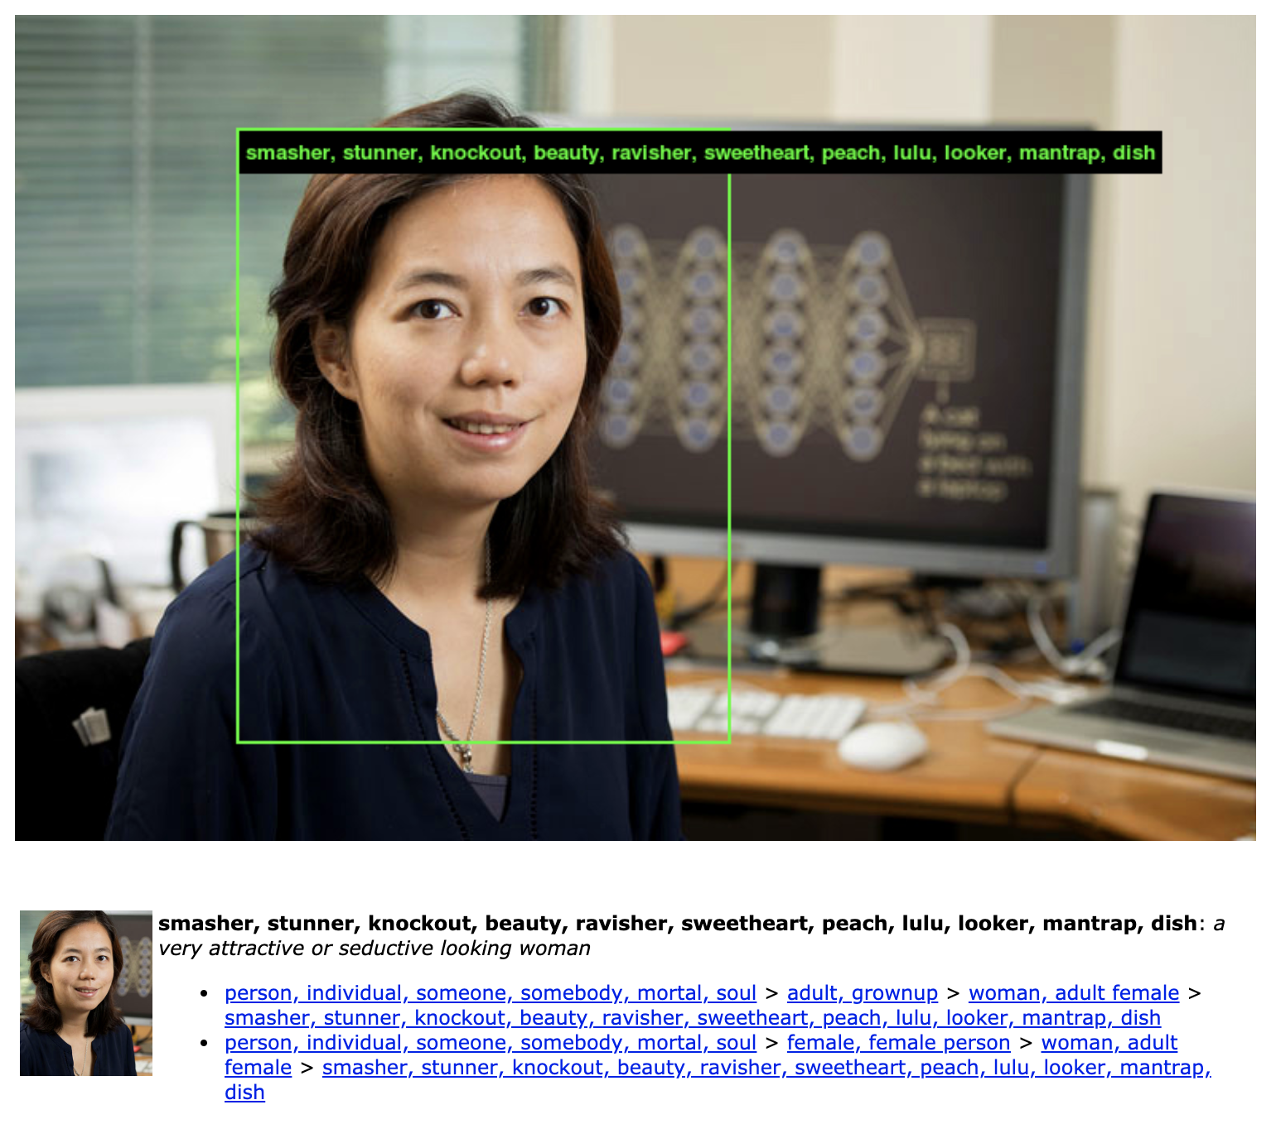
ImageNet
Takes words from WordNet
Uses a crowdsourcing and image search results to attach images to words from wordnet
Notes:
https://imagenet-roulette.paglen.com/

Slide 10
MNIST
Task: train ML to recognize digits from 70,000 handwriting samples
Can you?
State of the art accuracy: 0.23% error

Slide 11
So you need user data…
What should you collect?

Slide 12
Privacy in the 21st century
Information privacy
Protected (US) data types: Education data, health data, and financial data
Whose responsibility is privacy?
The individual?
Companies an individual interacts with?
Governments who regulate the companies?
Is privacy a fundamental human right?
What are sensible measures an individual should take to protect their privacy? When do sensible measures fail?

Slide 13
Limitations of Anonymity: What is a PII?
PII: Personally Identifiable Information

Slide 14
Limitations of Anonymity: What is a PII?
PII: Personally Identifiable Information
Anonymity is very (very) brittle to combining information sources
Most user data cannot be anonymized
What does this mean for ML pipelines?
Today companies have sensitive data
Ongoing advances in areas like federated learning

Slide 15
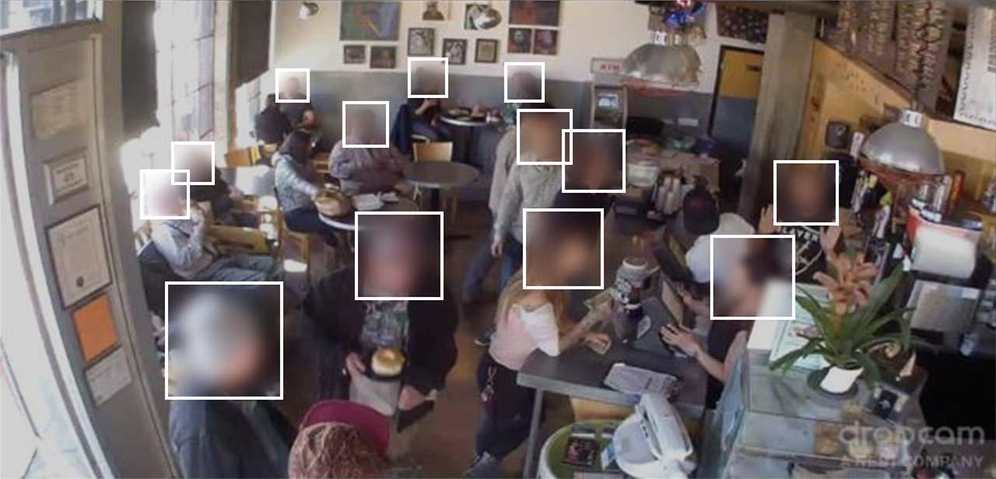
Some fun (?) datasets: Brainwash Cafe
“everyday life of a busy downtown cafe”
For head detection
https://purl.stanford.edu/sx925dc9385

Slide 16
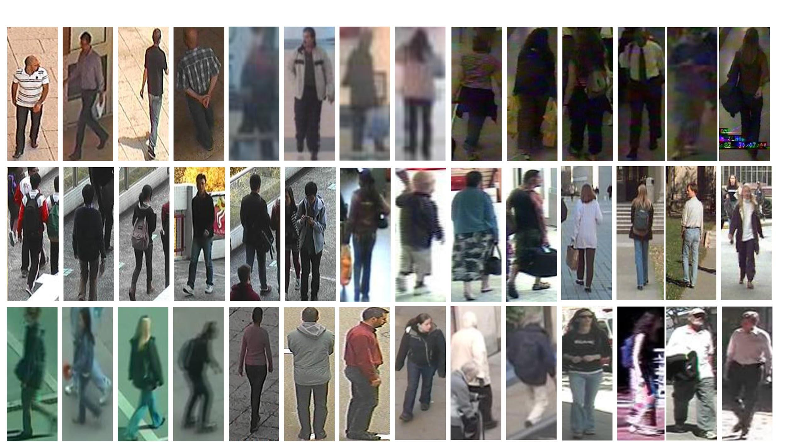
Some fun (?) datasets: People in various poses
Pedestrian Attribute Recognition At Far Distance; 19000 images
http://mmlab.ie.cuhk.edu.hk/projects/PETA.html

Slide 17
Some fun (?) datasets: what people do (Experian)
ConsumerView can take your business to the next level with thousands of data attributes available, such as:
Consumer demographics like age, gender, marital status, children and income.
Life event triggers like new parents, new homeowners, and new movers.
Automotive data that provides insight into the vehicles consumers have in their garages and the likelihood of households to purchase a vehicle.
Highly predictive financial segments, such as summarized credit statistics, based on Experian's national consumer credit file aggregated at an area level.
Purchase data that gives insight into past purchases and also predicts future buys across dozens of product categories.
Consumer decision-making styles and preferred marketing communication channels.
Attitudinal and behavioral data such as interests, hobbies and brand preferences.
Mosaic® USA lifestyle segmentation data that segments the country into 19 overarching groups and 71 underlying types.
Business information on millions of U.S. businesses including business owner data.
Technology attributes which provide vivid detail into the use and adoption of devices and even social media platforms.
Political personas that predict liberal to conservative and everything in between, even social attitudes and opinions.
http://www.experian.com/marketing-services/targeting/data-driven-marketing/consumer-view-data.html

Slide 18
Limitations of individuals guarding their information: Can consumers make informed choices?
Legalease is an issue in unclear information presented to users
Economic and social incentives for participation
Economic and social costs on privacy
Do you understand what you are giving away?
Notes:
http://www.ontla.on.ca/library/repository/mon/25008/312239.pdf

Slide 19
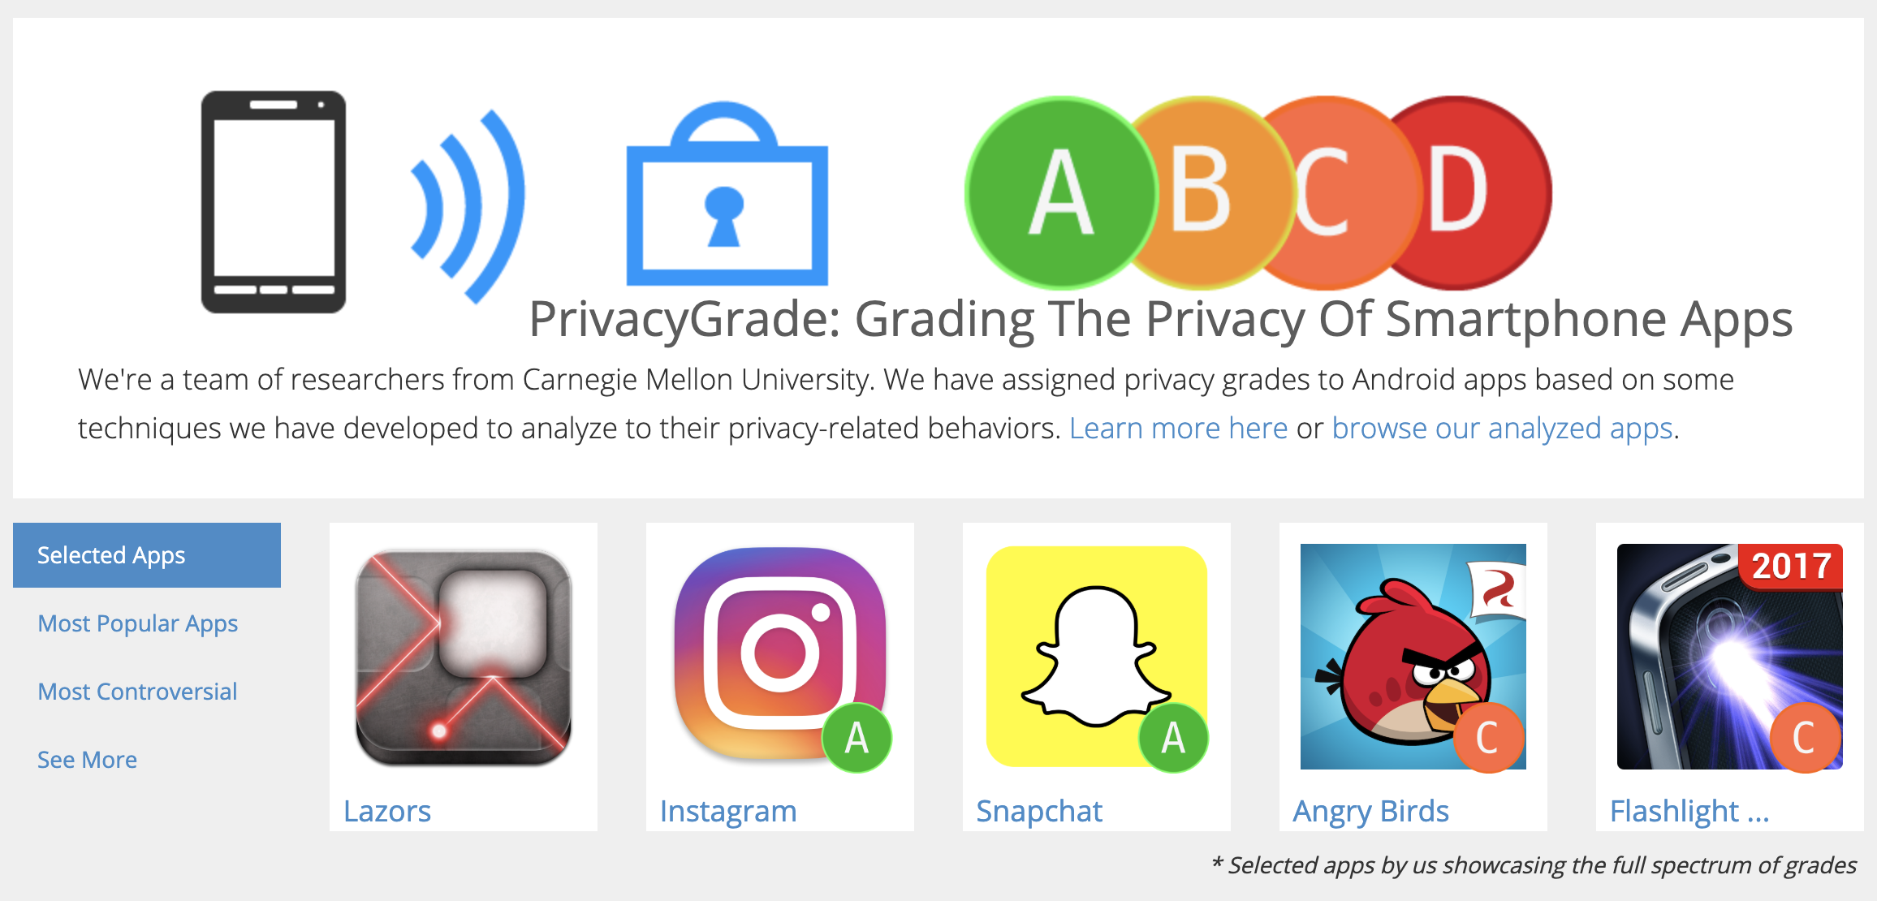
When are consumer’s expectations for privacy?
(Varies by culture and country)
Notes:
http://privacygrade.org/
Counter example: consumer expectation around voice assistants may have higher distrust and have higher expectations for poor data use than actually occurs
Policies versus in-practice AI, give example of ‘broken’ google home dot creeping

Slide 20
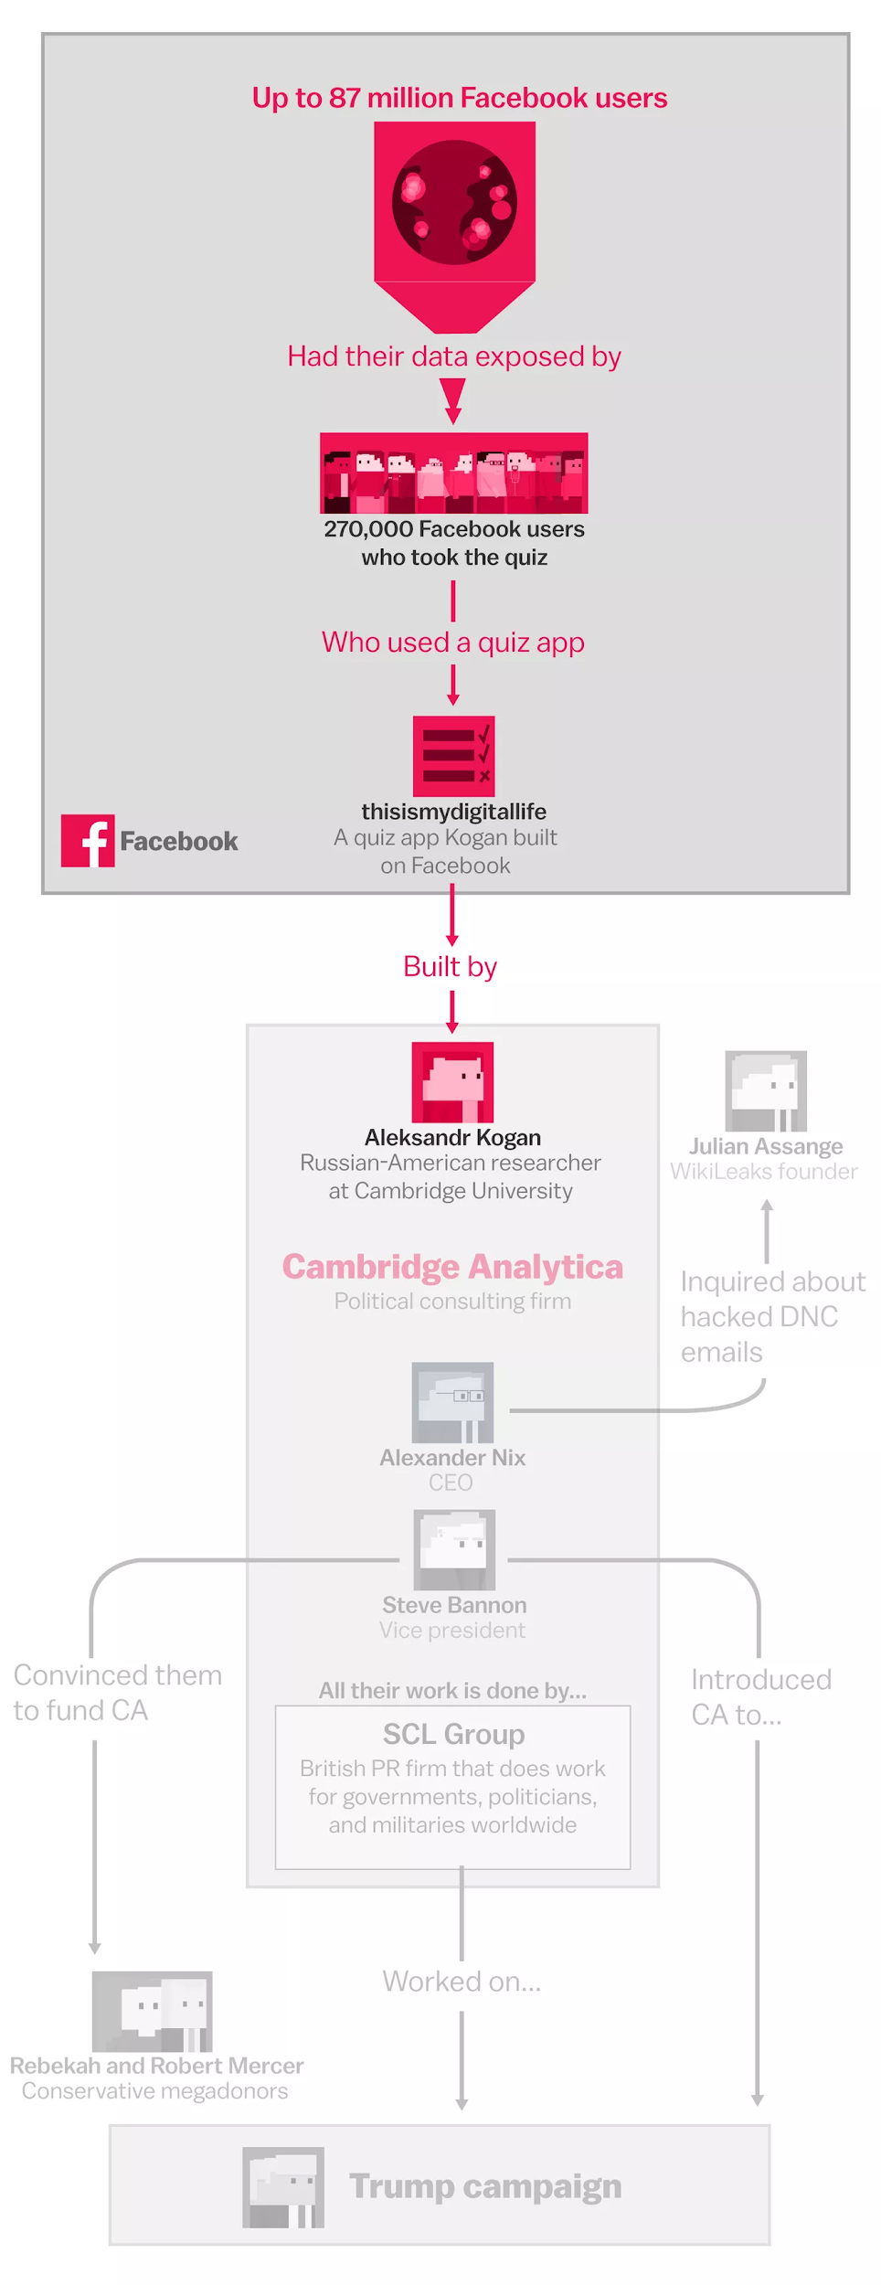
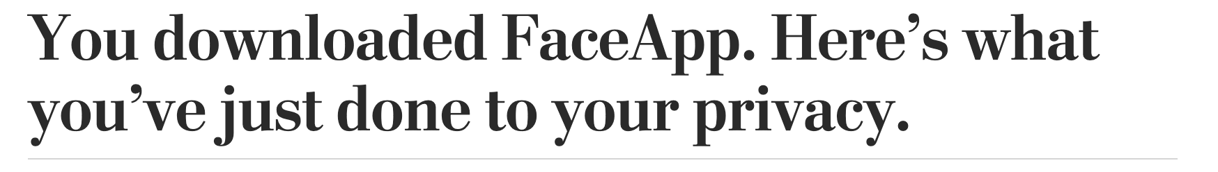
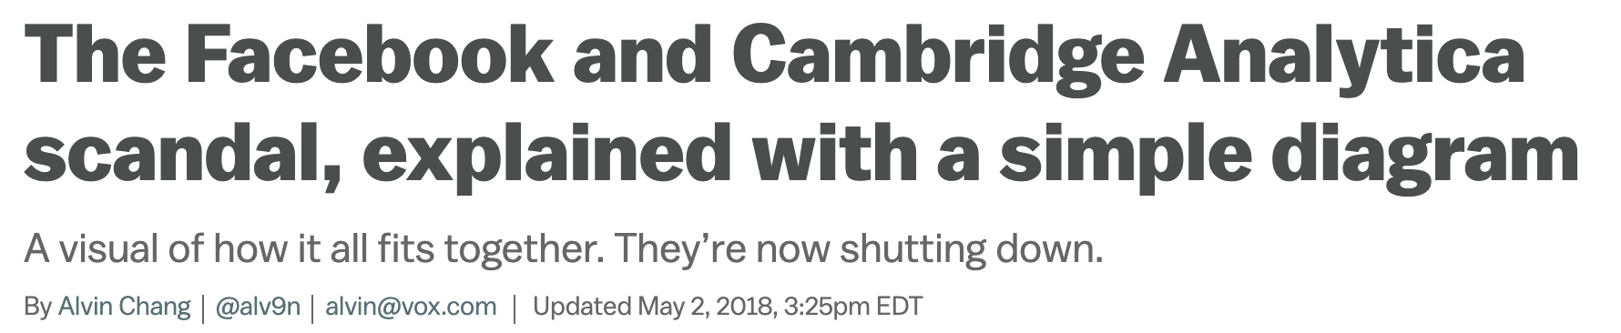
Tricking users in common, unethical, and dangerous
Washington Post
Vox
Notes:
https://www.washingtonpost.com/technology/2019/07/17/you-downloaded-faceapp-heres-what-youve-just-done-your-privacy/
https://www.vox.com/policy-and-politics/2018/3/23/17151916/facebook-cambridge-analytica-trump-diagram

Slide 21
Balance: satisfy user expectations for privacy & organization/company goals
Keep users trust
Privacy by design

Slide 22
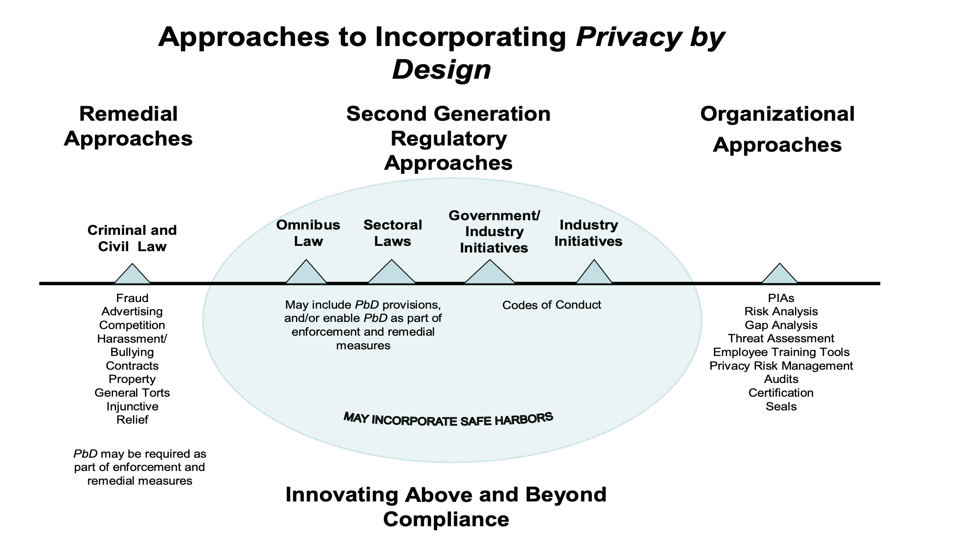
Service Design: Privacy by Design
Notes:
What is Safe Harbor in a privacy law setting? Here is means that the liability of the company may be limited if it can be proven that they acted in good faith and with reasonable measures.

Slide 23
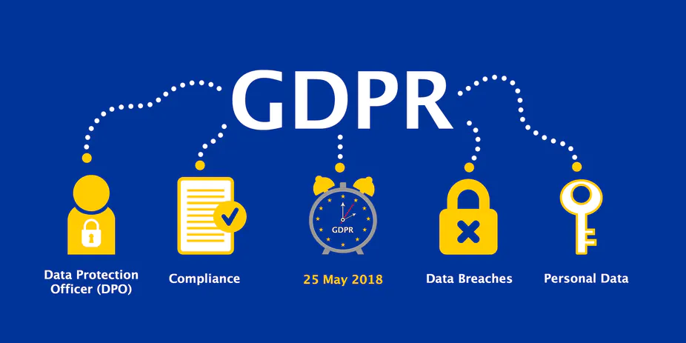
GDPR & Data Sovereignty
What is data sovereignty?
GDPR is “General Data Protection Regulation” of the EU
Did you notice all those cookie consent forms?

Slide 24
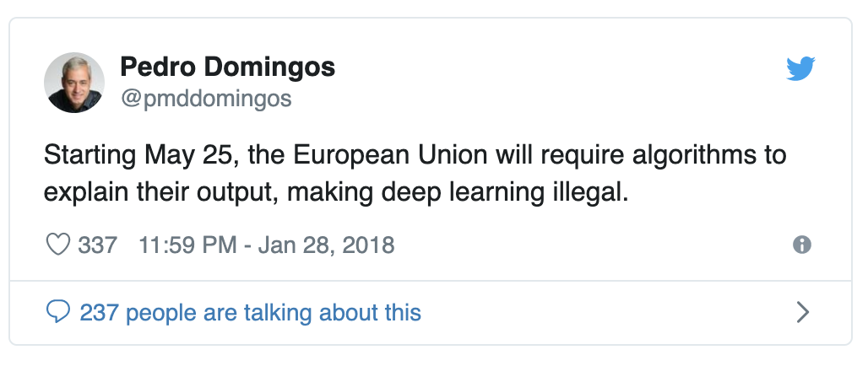
GDPR: Right to AI/ML explanation & no bias
ML Researchers reacting to GDPR
Currently more of a recommendation than an enforceable law
companies foreseeing future laws
Spurs investment in Explainable AI and AI Fairness
Not quite
Notes:
https://www.kdnuggets.com/2018/03/gdpr-machine-learning-illegal.html

Slide 25
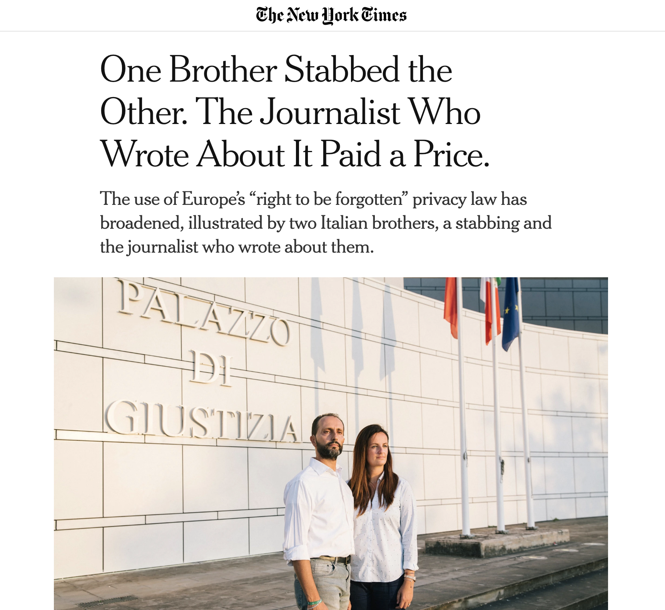
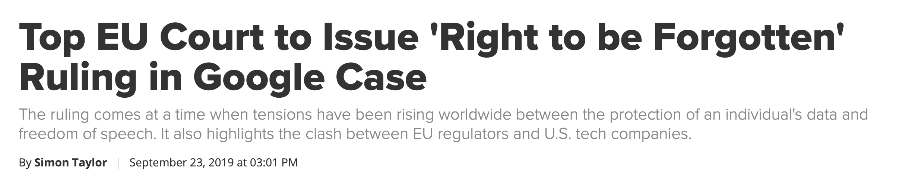
GDPR: Right to be forgotten
Google Spain v AEPD and Mario Costeja González
Right to ask a search engine to remove a listing globally if it pertains to an individual
Privacy Vs. Freedom of Speech
Notes:
https://en.wikipedia.org/wiki/Google_Spain_v_AEPD_and_Mario_Costeja_Gonz%C3%A1lez
https://www.nytimes.com/2019/09/23/technology/right-to-be-forgotten-law-europe.html
https://www.law.com/2019/09/23/top-eu-court-to-issue-right-to-be-forgotten-ruling-in-google-case-292-53884/?slreturn=20190823194124
Right to be forgotten in the US
https://publicpolicy.googleblog.com/2015/06/revenge-porn-and-search.html

Slide 26
Identity and personal data rights?
What do you think?

